Slide 1
Linguistic Distance and Patterns of Economic Growth
Kyle Chan
April 13, 2016

Slide 2
Big picture question:
Why does global inequality across countries exist?

Slide 3
Most scholars and policymakers have focused on the characteristics of individual countries
In economics, the neoclassical (Solow) growth model focuses on:
Savings rate
Labor supply
Capital stock
Other common variations on this approach within economics and political science focus on:
Quality of institutions
Openness to trade
Regime type (democratic vs. authoritarian)
Too econ / polisci. Substitute with more sociology?

Slide 4
But there may be deeper patterns that cut across countries
Geography
Language
Religion
Colonial legacy
Communism
Trade networks
Have citations for lots of these studies. Even some soc ones (e.g. Walder)

Slide 5
And, of course, everything is extremely endogenous

Slide 6
And, of course, everything is extremely endogenous
Geography
Language
Religion
Colonial legacy
Communism
Trade networks
Savings rate
Labor supply
Capital stock
Institutions
Openness to trade
Regime type
Economic growth

Slide 7
Some progress has been made in finding cross-country clusters
Creanza et al (2015) “A Comparison of Worldwide Phonemic and Genetic Variation in Human Populations” Proceedings of the National Academy of Science
Etc.
Worried about mentioning anything related to genetics as that will immediately distract

Slide 8
Diffusion of ideas as a key mechanism?
Spolaore, Wacziarg (2009) “The Diffusion of Development” Quarterly Journal of Economics
Comin, Hobijn (2010) “An Exploration of Technology Diffusion” American Economic Review
Wejnert (2005) “Diffusion, Development, and Democracy, 1800-1999” American Sociological Review
Saxonhouse (1974) “A Tale of Japanese Technological Diffusion in the Meiji Period” Journal of Economic History
At some point, I need to try harder to sound like a sociologist

Slide 9
Diffusion of ideas as a key mechanism?
Science and technology
Including “organizational technology” – e.g. double-entry bookkeeping
Social norms
E.g. punctuality
Institutional forms
Cultural tastes
E.g. the soap opera matrix
Turkish soap operas -> Middle East
Mexican soap operas -> Latin America, Russia?
Korean soap operas -> Northeast Asia, Morocco?

Slide 10
Theoretical framework
Deeper patterns
Proximate growth factors
Development patterns
Diffusion of ideas

Slide 11
Theoretical framework
Diffusion of ideas
Deeper patterns
Proximate growth factors
Development patterns
Reduced form

Slide 12
Project research question:
Is there a relationship between linguistic distances and economic growth patterns?
(even after controlling for geographic distance)

Slide 13
Point of clarification
This project will examine the relationship between linguistic distance and economic growth patterns
Not levels of economic development (i.e. per capita GDP)
Not overall growth rates (which are partly a function of income level)
Others have done these tests already and found a strong relationship (Spolare, Wacziarg QJE paper; Desmet; etc.)
Focus more on timing and other patterns
E.g. Post-WWII growth miracle affects Western European growth rates around the same time and differs from shape of growth pattern for East Asian NICs

Slide 14
Data

Slide 15
Three datasets
Linguistic
Ruhlen database of phonemic presence/absense
728 phonemes
Economic
Historical per capita GDP data from 1 AD to present
Complete 1950-2008 income data for 115 countries
Geographic
Latitude and longitude for all countries
Source: Google
2,082 languages
Source: Creanza et al (2015) PNAS paper
Source: Maddison Project

Slide 16
Methodological Approach

Slide 17
Step 1: Create linguistic, economic growth, and geographic distance matrices
Linguistic:
Select one plurality language per country (automatic + manual)
Jaccard distance on phonemes
Economic:
Get 5-year compound annual growth rates (CAGRs) for 1950-2008 by country
Standardize these growth rates within each country (i.e., mean=0, SD=1)
Euclidean distance between each country’s set of growth rates
Geographic:
great-circle distance (haversine formula) on latitude and longitude

Slide 18
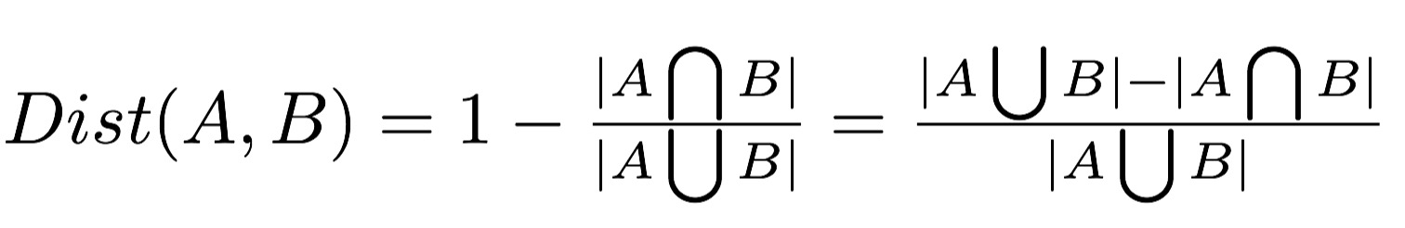
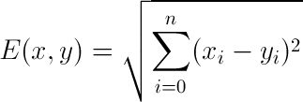
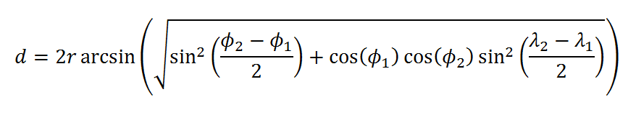
Distance formulas
Jaccard:
Euclidean:
Haversine:

Slide 19
Step 2: Run Mantel test on distance matrices
Use simple Mantel test to check for significant relationship between two distance (dissimilarity) matrices
Running standard regression on distances matrices doesn’t work due to autocorrelation
Mantel test randomly permutes rows and columns of one matrix to see if this will yield a higher correlation coefficient
Use partial Mantel test to check for relationship between linguistic and economic distance while controlling for geographic distance
Given distance matrices X, Y, and Z: get residuals X’ and Y’ from regression on Z, then run Mantel test on X’ and Y’

Slide 20
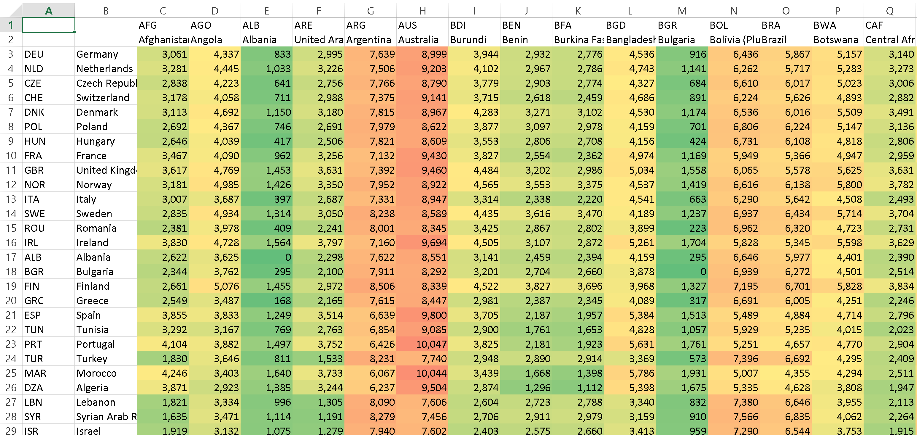
Distance matrix (Germany, in miles)

Slide 21
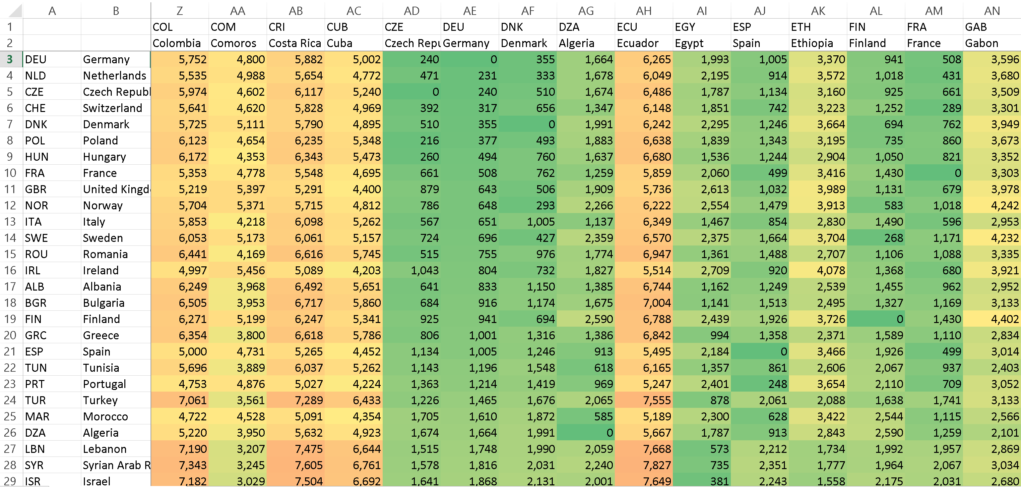
Distance matrix (Germany, in miles)

Slide 22
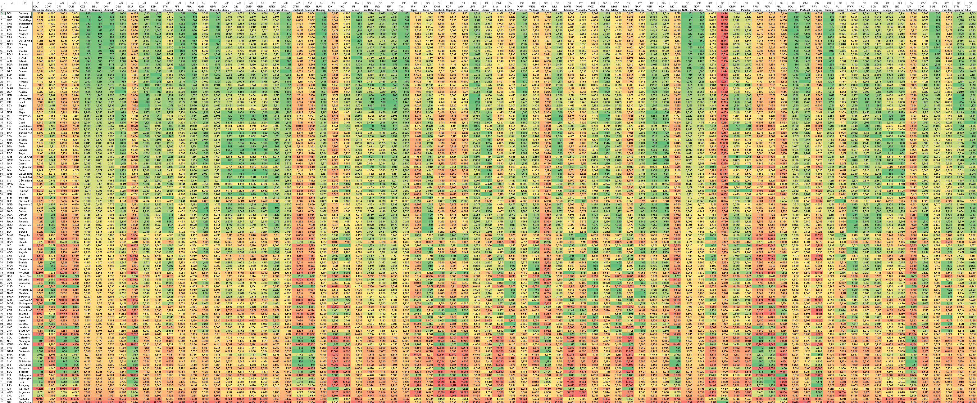
Distance matrix (all countries)

Slide 23
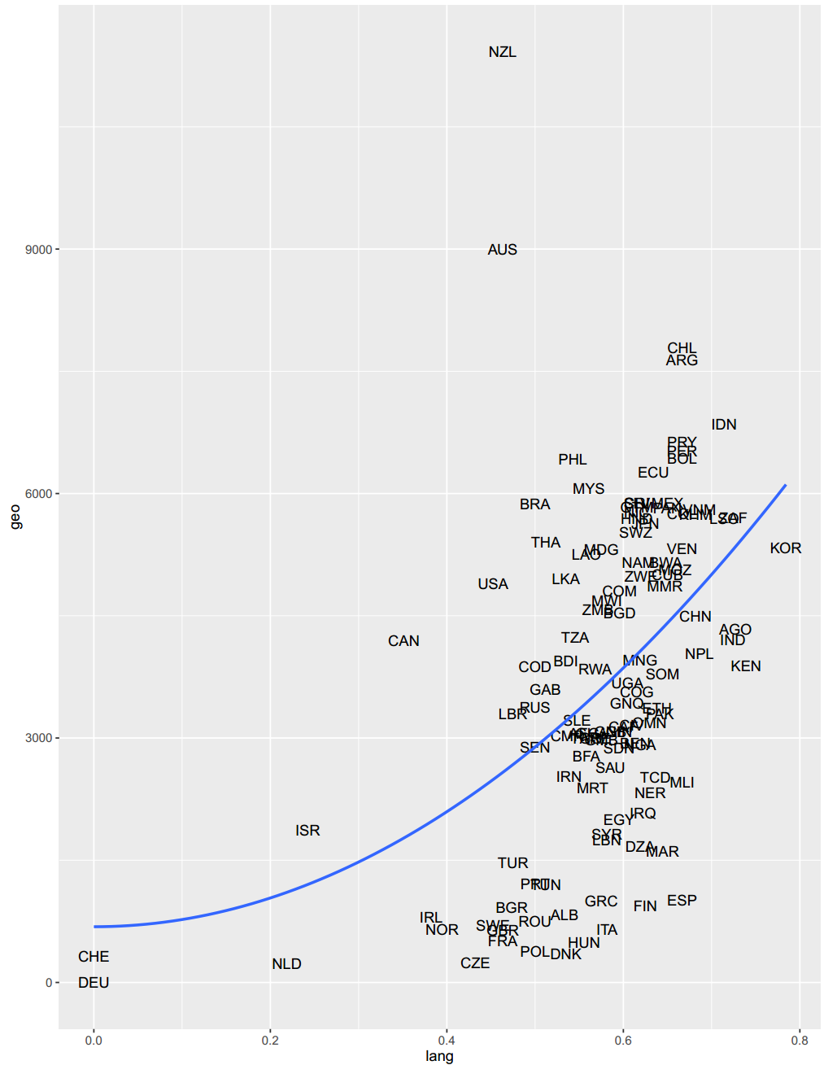
Geographic vs. linguistic distance (Germany)

Slide 26
Results

Slide 27
Main result: there exists a significant relationship between linguistic distance and economic growth pattern distance
Mantel statistic based on Pearson's product-moment correlation
Call:
mantel(xdis = growth.dist.matrix, ydis = lang.dist.matrix, permutations = 99999)
Mantel statistic r: 0.1825
Significance: 1e-05
Upper quantiles of permutations (null model):
90% 95% 97.5% 99%
0.0497 0.0645 0.0771 0.0928
Permutation: free
Number of permutations: 99999

Slide 28
Main result: this relationship remains significant when controlling for geographic distance
Partial Mantel statistic based on Pearson's product-moment correlation
Call:
mantel.partial(xdis = growth.dist.matrix, ydis = lang.dist.matrix, zdis = geo.dist.matrix, permutations = 99999)
Mantel statistic r: 0.1708
Significance: 3e-05
Upper quantiles of permutations (null model):
90% 95% 97.5% 99%
0.0507 0.0662 0.0793 0.0944
Permutation: free
Number of permutations: 99999

Slide 29
Caveat: 15 manual language substitutions
Country | Original | Substitute
Afghanistan | Farsi | Pashto
Australia | Dhuwal | British English
Argentina | Quechua | Colombian Spanish
Bolivia | Quechua | Colombian Spanish
Botswana | Naron | Tswana
Switzerland | Romansch | German
Chile | Mapudungu | Colombian Spanish
Guatemala | Quiche | Costa Rican Spanish
Honduras | Lenca | Costa Rican Spanish
Nicaragua | Subtiaba | Costa Rican Spanish
New Zealand | Maori | British English
Peru | Quechua | Colombian Spanish
Paraguay | Guarani | Colombian Spanish
El Salvador | Pipil | Costa Rican Spanish
Venezuela | Warao | Colombian Spanish

Slide 30
But simple Mantel test of economic on linguistic still holds
Mantel statistic based on Pearson's product-moment correlation
Call:
mantel(xdis = growth.dist.matrix, ydis = lang.dist.matrix, permutations = 99999)
Mantel statistic r: 0.166
Significance: 8e-05
Upper quantiles of permutations (null model):
90% 95% 97.5% 99%
0.0523 0.0677 0.0808 0.0969
Permutation: free
Number of permutations: 99999

Slide 31
And partial Mantel test controlling for geography still holds
Partial Mantel statistic based on Pearson's product-moment correlation
Call:
mantel.partial(xdis = growth.dist.matrix, ydis = lang.dist.matrix, zdis = geo.dist.matrix, permutations = 99999)
Mantel statistic r: 0.141
Significance: 0.00045
Upper quantiles of permutations (null model):
90% 95% 97.5% 99%
0.0519 0.0675 0.0809 0.0961
Permutation: free
Number of permutations: 99999

Slide 32
Everything still holds for Europe only and ex-Europe
 |  | All World | All World (no edits) | Europe | ex-Europe
 | Countries | 115 | 115 | 21 | 94
 | Years | 1950-2008 | 1950-2008 | 1950-2008 | 1950-2008
Simple | Mantel r | 0.1825 | 0.166 | 0.1595 | 0.1719
Simple | Mantel P-value | 1.00E-05 | 8.00E-05 | 0.04685 | 4.00E-05
Geo-controlled | Mantel r | 0.1708 | 0.141 | 0.1691 | 0.1629
Geo-controlled | Mantel P-value | 3.00E-05 | 0.00045 | 0.0377 | 1.00E-04
 | Permutations | 99999 | 99999 | 99999 | 99999

Slide 33
Things I’ve checked
Mantel tests seem to work
Used randomized versions of the data and Mantel said they were random
Did the same for partially randomized versions and got P-values that were in between full random and no random
Also, used different R packages for Mantel with same result
Spot checks on all the distance matrices

Slide 34
List of worries
Problems with Mantel test? Partial Mantel?
Sufficient number of random permutations?
Use distance-based Moran’s eigenvector maps (dbMEM) instead?
Not standardize the growth rates? Standardize the other matrices?
Unstandardized simple Mantel: r=0.1024, p-value=0.05731
Unstandardized partial Mantel: r=0.112, p-value=0.0449
Log geographic distances?
Add control for income level?
Is Jaccard really best?
Are there better linguistic datasets than phonemes from Ruhlen?
Maybe just stick with Ethnologue per economists?

Slide 35
Next steps
Subset for specific regions: Europe, Middle East / North Africa, Asia
For Europe only, can use more historical data, e.g. from 1800s
Also, subset by ex-Latin America, ex-Sub-Saharan Africa, ex-Anglo
Find country-pairs with strong divergence on any two measures, like fault lines
E.g. Eastern vs. Western Europe, Northeast vs. Southeast Asia
Hierarchical clustering across all dimensions
Add new distance matrix for World Values Survey? (low priority)

Slide 36
Linguistic Distance and Patterns of Economic Growth
Kyle Chan
April 13, 2016

